Slide 1

How to Complete the INDIGENT DEFENSE EXPENDITURE REPORT (IDER) Criminal/Juvenile Delinquency Edition
October 3, 2025
Edwin Colfax, Director of Grant Funding
Debra Stewart, Fiscal Analyst
Notes:
Good afternoon everyone. I am Debra Stewart I am the fiscal monitor for the Texas Indigent Defense Commission. With me today we have Dylan Moench of the Childrens commission He will be presenting virtually and Crystal Leff –Pinon and Edwin Colfax. Crystal is a new employee with TIDC and she is tasked it is to oversee the CPS program.
The title for today’s presentation is an Introduction to new CPS reporting requirements on the TIDC Indigent Defense Expenditure Report.
On November 1st, the IDER is due and this year there is a new section in which you will provide CPS case information. This information is requested to be submitted by you via Senate Bill 560 of the 86Th legislative session.
Next slide please

Slide 2
Mission: Protecting the right to counsel, improving public defense
Funding
Oversight
Improvement
Notes:
Just to share with you: The Mission of TIDC and that is
Protecting the right to counsel, improving public defense.

Slide 3
Goals for Today’s Session
Overview of the Indigent Defense Expenditure Report (IDER)
Review the data reported on the Criminal/Juvenile Delinquency IDER
Walk-Through of TIDC’s IDER website
Q & A
Notes:
I am going to start with a quick overview of TIDC in our traditional role with criminal case reporting and I will review with you the IDER reporting platform and show you where and how we want you to report the CPS expenditures and appointment numbers. Then we ill discuss our Phase 1 and Phase 2 plans. After which When I turn over the presentation to Dylan to discuss
and Crystal they will focus on the CPS information
.
We want to Introduce the new reporting requirement from Texas Legislature on CPS Appointments
We want to Show you where and how to report the CPS data on the existing Indigent Defense Expenditure Report
We want to Explain the phased data collection plan and the categories that we would like you to track for next year
We want to Provide background on CPS representation and why tracking data is important
We want Introduce the model Attorney fee Voucher for CPS appointments that will facilitate the tracking of this data
Then we
We will open the floor up for Q & A at the end .But if you have a question as we go through the presentation. I believe you can type it into chat window and the moderator can interrupt us if they feel it should not wait until the end.
Next slide please

Slide 4
Indigent Defense Expenditure Report (IDER)
WHO: All county auditors or financial officers
WHAT: Annual report of county indigent defense expenditures and cases
WHEN: Due November 1st
WHERE: TIDC’s NEW Reporting Website!
WHY: Statutory requirement
HOW: Today’s Topic
Notes:
For criminal cases.
We look at Adult Felony and A & B level misdemeanor
We also look at Juvenile delinquency and/or Child in need of supervision.(CINS) cases
Next slide please

Slide 5
Three Report Modules in IDER System
Criminal & Juvenile Delinquency IDER
Family Protection IDER (covering appointments in CPS cases)
OCA Court Ordered Interpretation Service Expenditures Report

Slide 6
Court Interpretation Services Report to OCA
Required of county financial officers
88th Legislature - SB380/HB3474
Separate report to OCA built into new IDER portal
Expenditures on court-ordered interpretation services in criminal and civil proceedings
For full details and instructions, visit
https://www.txcourts.gov/statistics/court-ordered-interpretation-service-expenditures/

Slide 7
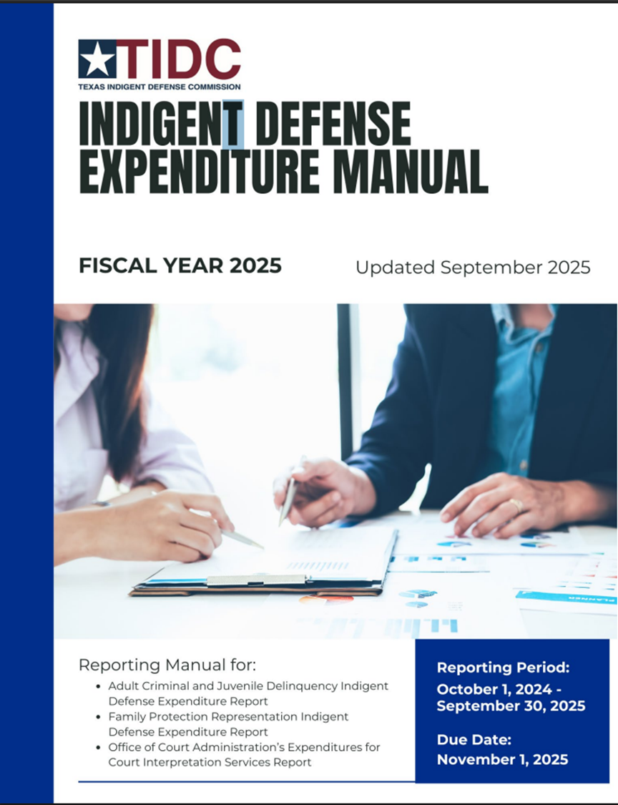
Indigent Defense Expenditure Report (IDER) Manual https://www.tidc.texas.gov/media/sjlncgtm/fy2025-indigent-defense-expenditure-manual.pdf
Notes:
For criminal cases.
We look at Adult Felony and A & B level misdemeanor
We also look at Juvenile delinquency and/or Child in need of supervision.(CINS) cases
Next slide please

Slide 8
What Data is Reported on the Crim./Juv. IDER?
County-wide Data
Payments to/from regional defense programs
itemize payments
Reimbursements
- From defendants for indigent defense costs
- From TX Comptroller for 11.071 death penalty writs
- Other non-TIDC funding for indigent defense
Public Defender Office Expenditures
MAC Program Expenditures
Limited Scope Representation Expenditures & Cases

Slide 9
What Data is Reported on the Crim./Juv. IDER?
Court Level Data
For each court:
Amounts expended, categorized by
Counsel type (Assigned Counsel, PD, MAC, Contract)
Expenditure type (Attorney fees, Investigation, Expert Witness, Other Litigation Expenses
Case type (Non-capital Felony, Capital, Misdemeanor, Juvenile, Appeals
Case counts paid/disposed, categorized by
Case type (felony, misdemeanor, juvenile, appeal, etc.)
Counsel type (Assigned Counsel, Public Defender, MAC, Contract)

Slide 10
What Data is Reported on Court Reports of the Crim./Juv. IDER?
Defense Costs Only
Adult Criminal Cases
Felony
Class A & B Misdemeanor
Juvenile Delinquency Cases
Include
Attorney Fees
Investigator Fees
Expert Witness Fees
Other Litigation Expenses
Notes:
For criminal case reporting we do NOT look at civil cases which includes the CPS cases that we are discussing today.
It does NOT look at class C misdemeanors which are usually your traffic offenses nor any other non-jailable cases.

Slide 11
What expenses and cases should NOT be included in Criminal/Juvenile IDER?
Do not include the following expenses in the Criminal/Juvenile IDER:
Civil cases and expenses
Family protection appointments (i.e., CPS or child protection cases filed by DFPS) are reported in the Family Protection IDER (separate training)
Attorney General child support enforcement cases
Class C misdemeanors (e.g., traffic offenses, other non-jailable offenses)
Competency to Stand Trial Mental Health Evaluations
General court expenses – court reporters, interpreters, etc. (Court Interpreter info is reported in the new OCA Court Interpretation Report only)
Notes:
For criminal case reporting we do NOT look at civil cases which includes the CPS cases that we are discussing today.
It does NOT look at class C misdemeanors which are usually your traffic offenses nor any other non-jailable cases.

Slide 12
Questions about the Criminal/Juvenile IDER?
Website/Login Issues
tidc@tamu.edu (979)845-6754
Crim/Juv IDER Report Content Questions
Debra Stewart
dstewart@tidc.texas.gov
512-936-7561
Edwin Colfax
ecolfax@tidc.texas.gov
512-463-2508
Notes:
For criminal case reporting we do NOT look at civil cases which includes the CPS cases that we are discussing today.
It does NOT look at class C misdemeanors which are usually your traffic offenses nor any other non-jailable cases.

Slide 13

REPORTING WEBSITE
tidc.it.tamu.edu

Slide 14
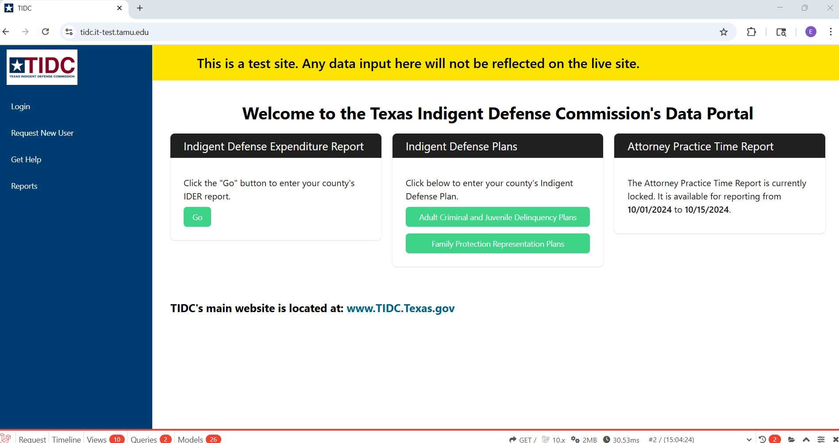

Slide 15
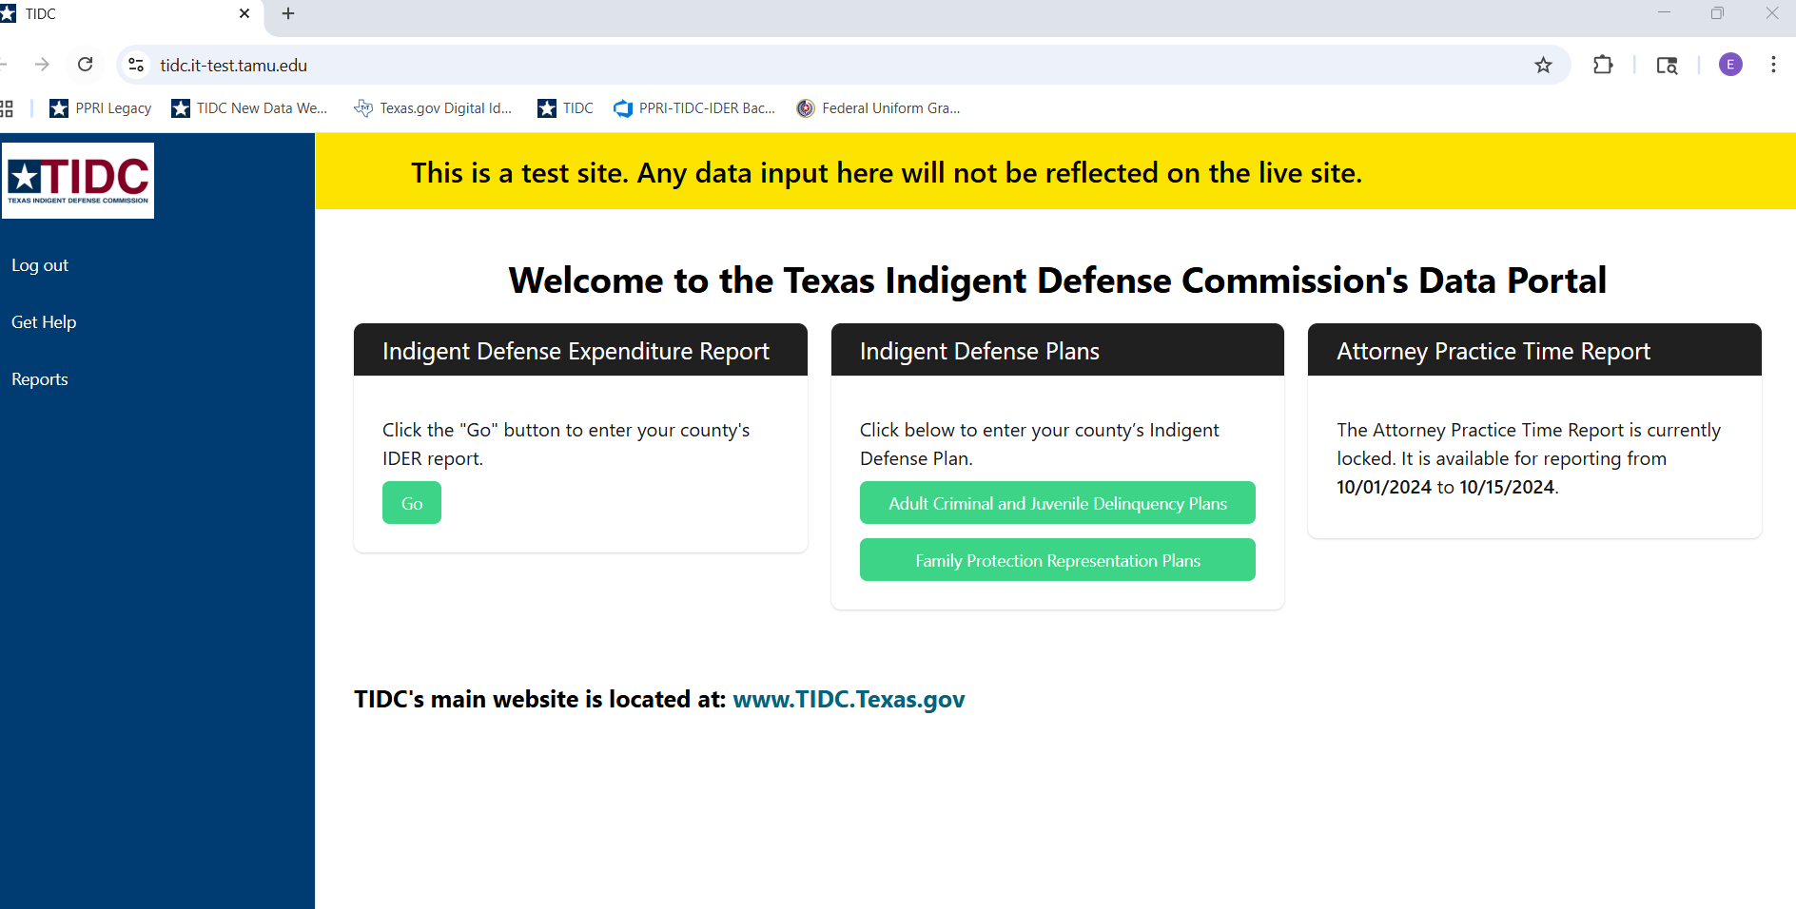

Slide 16
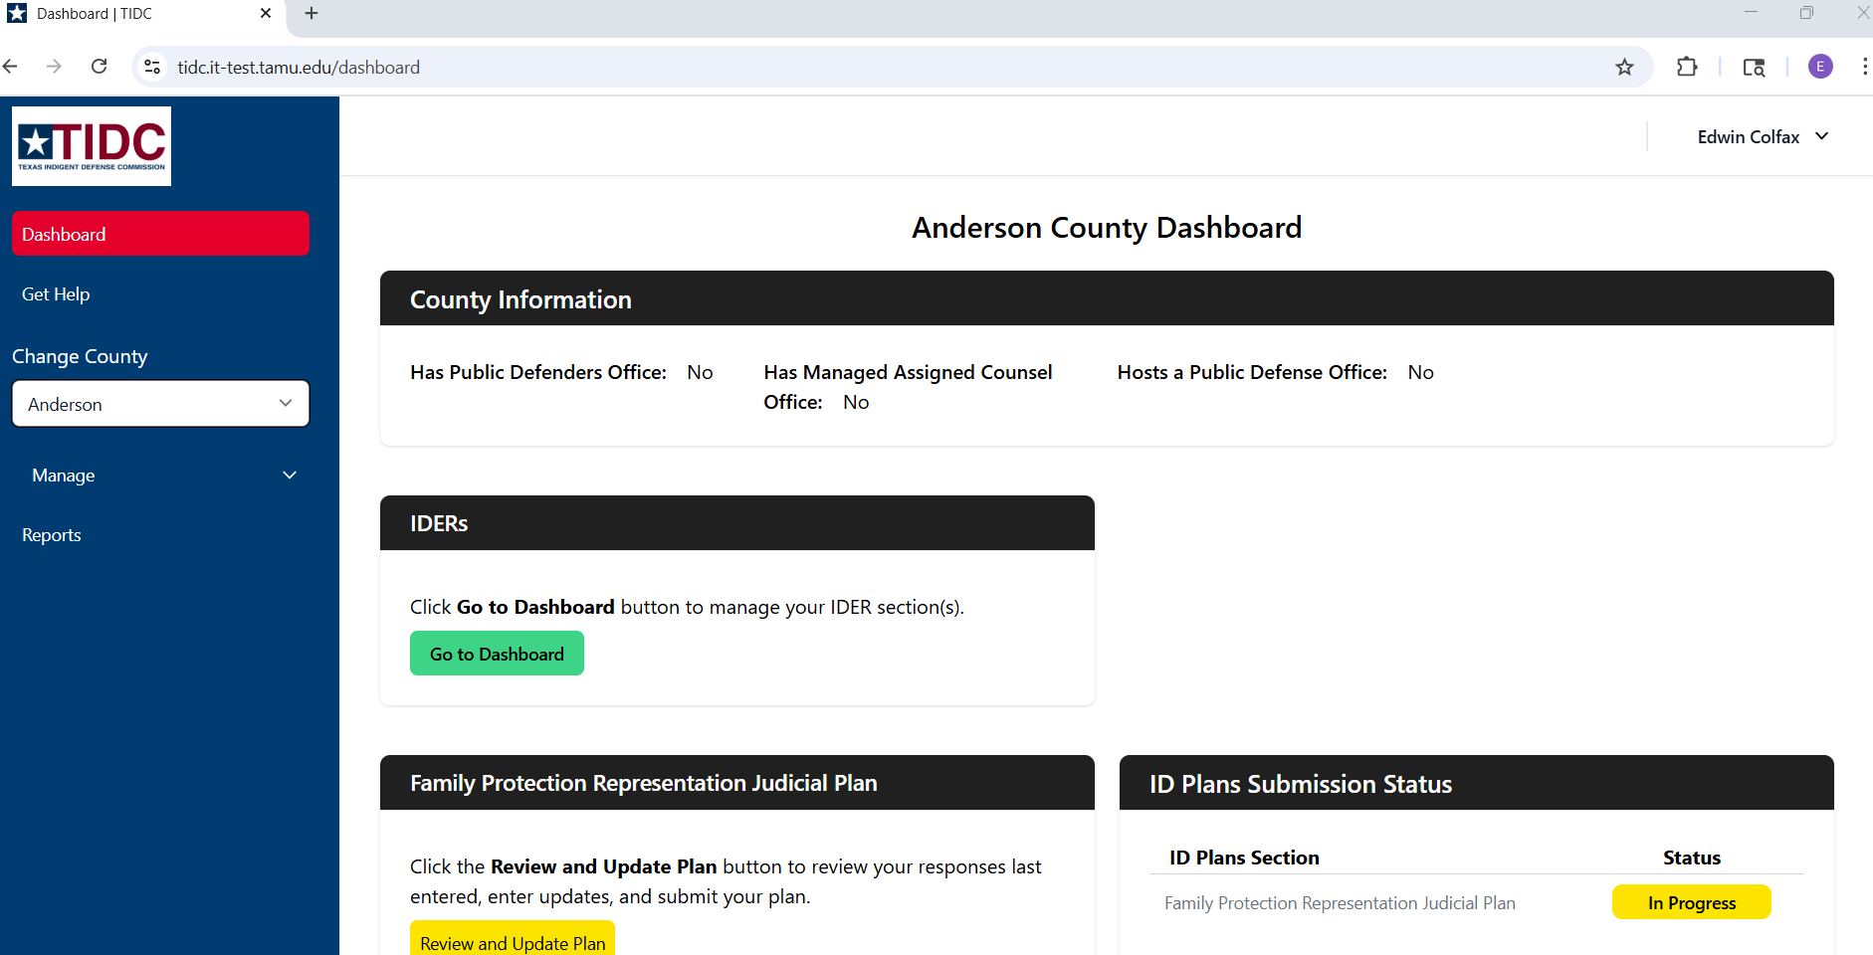

Slide 17
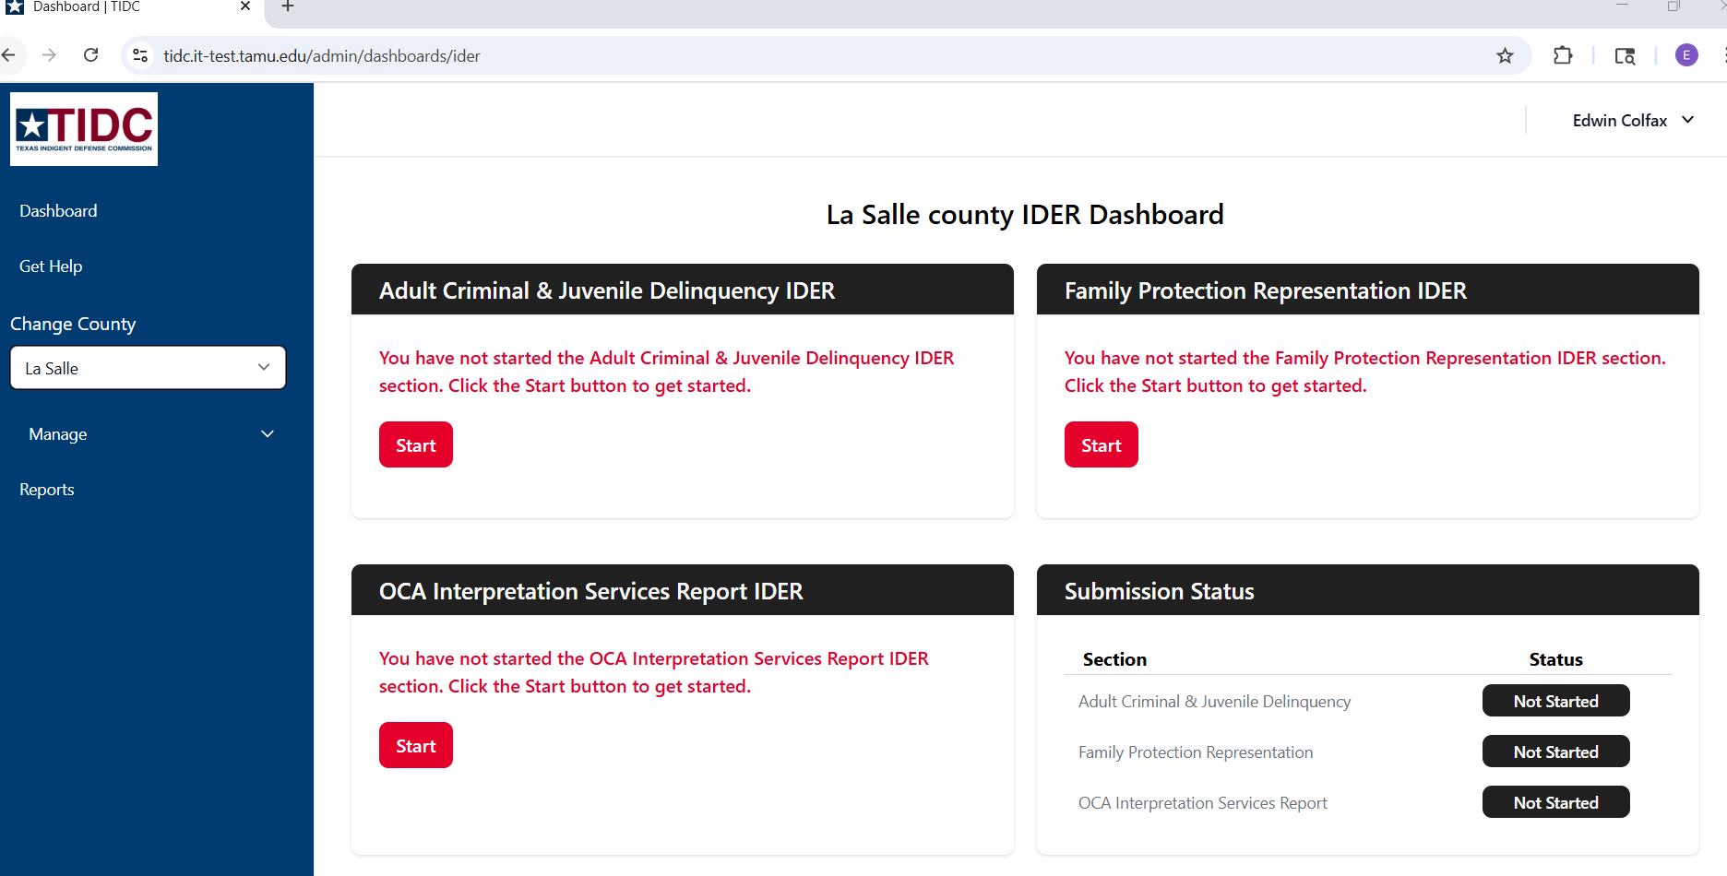

Slide 18
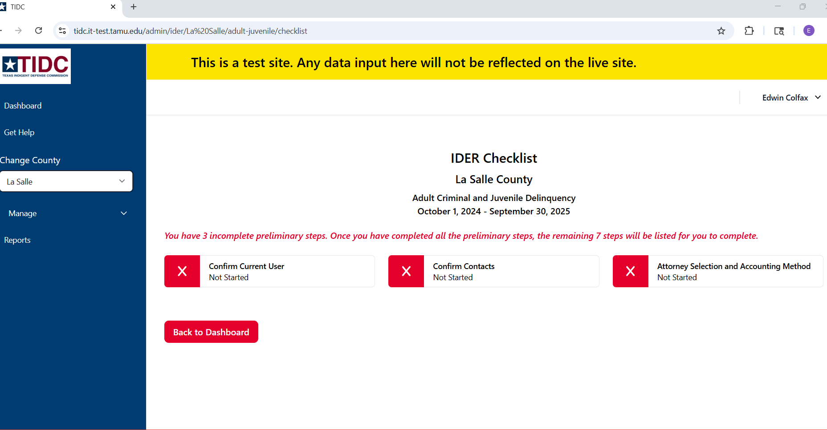

Slide 19
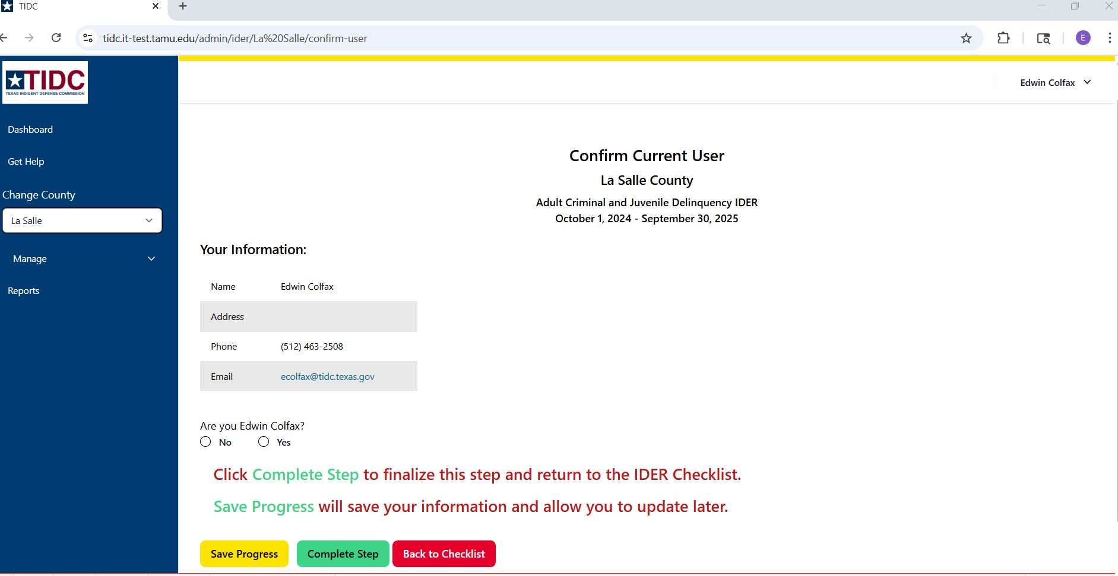

Slide 20
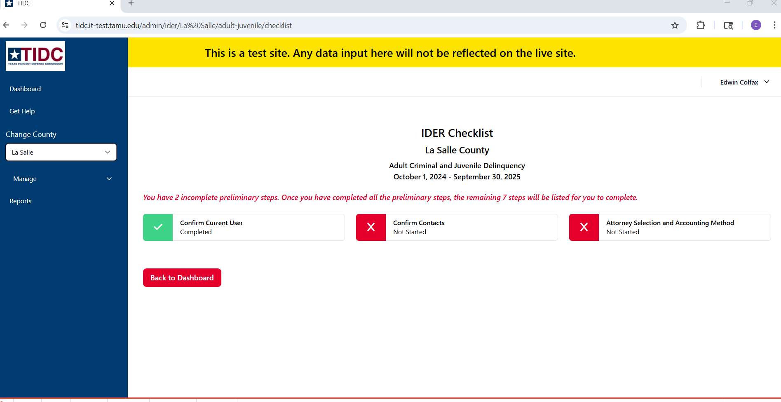

Slide 21
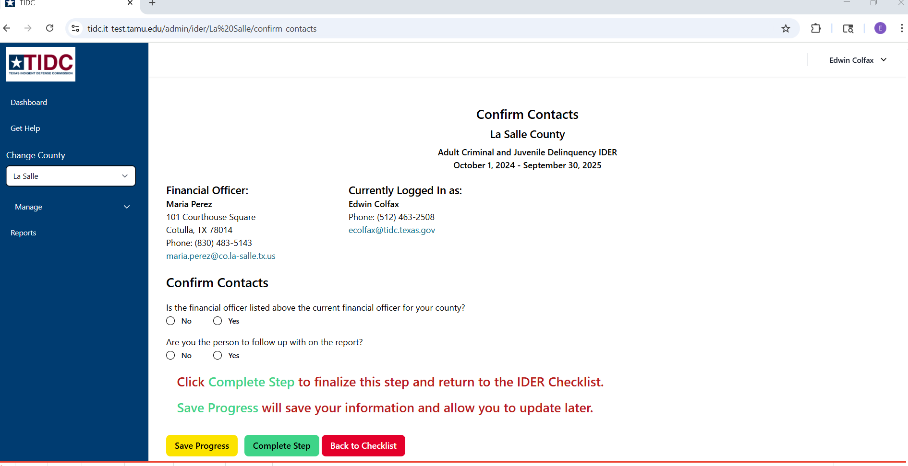

Slide 22
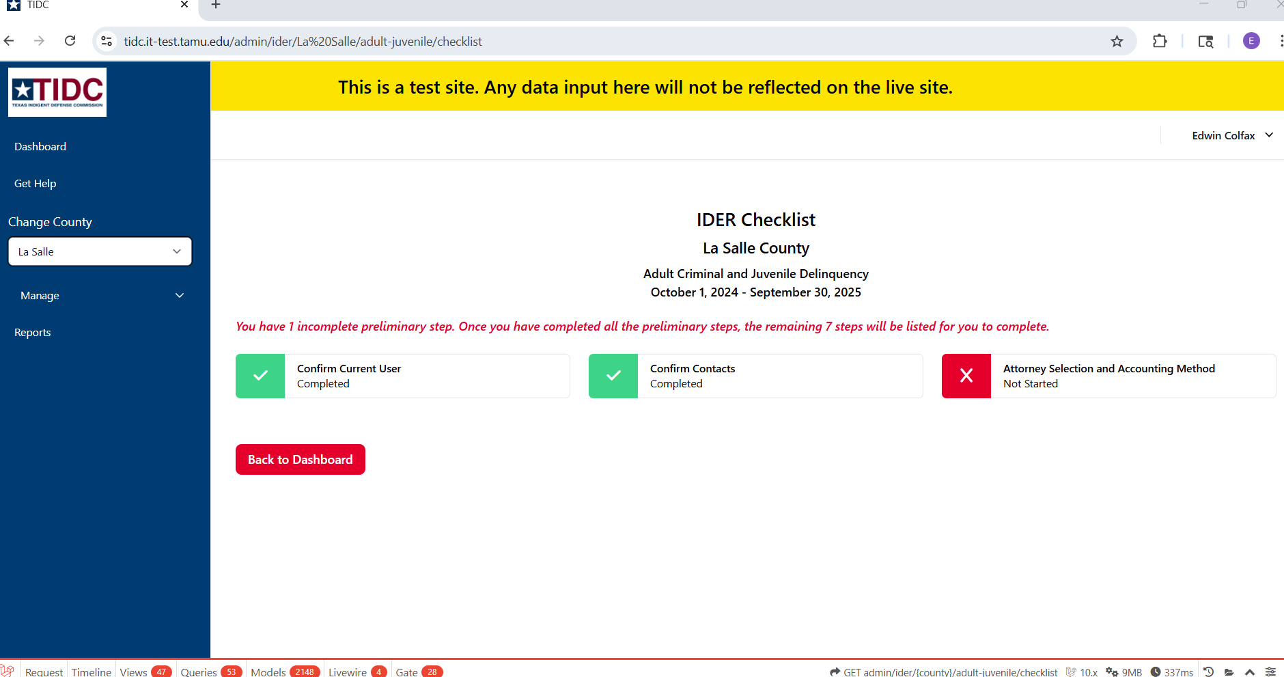

Slide 23
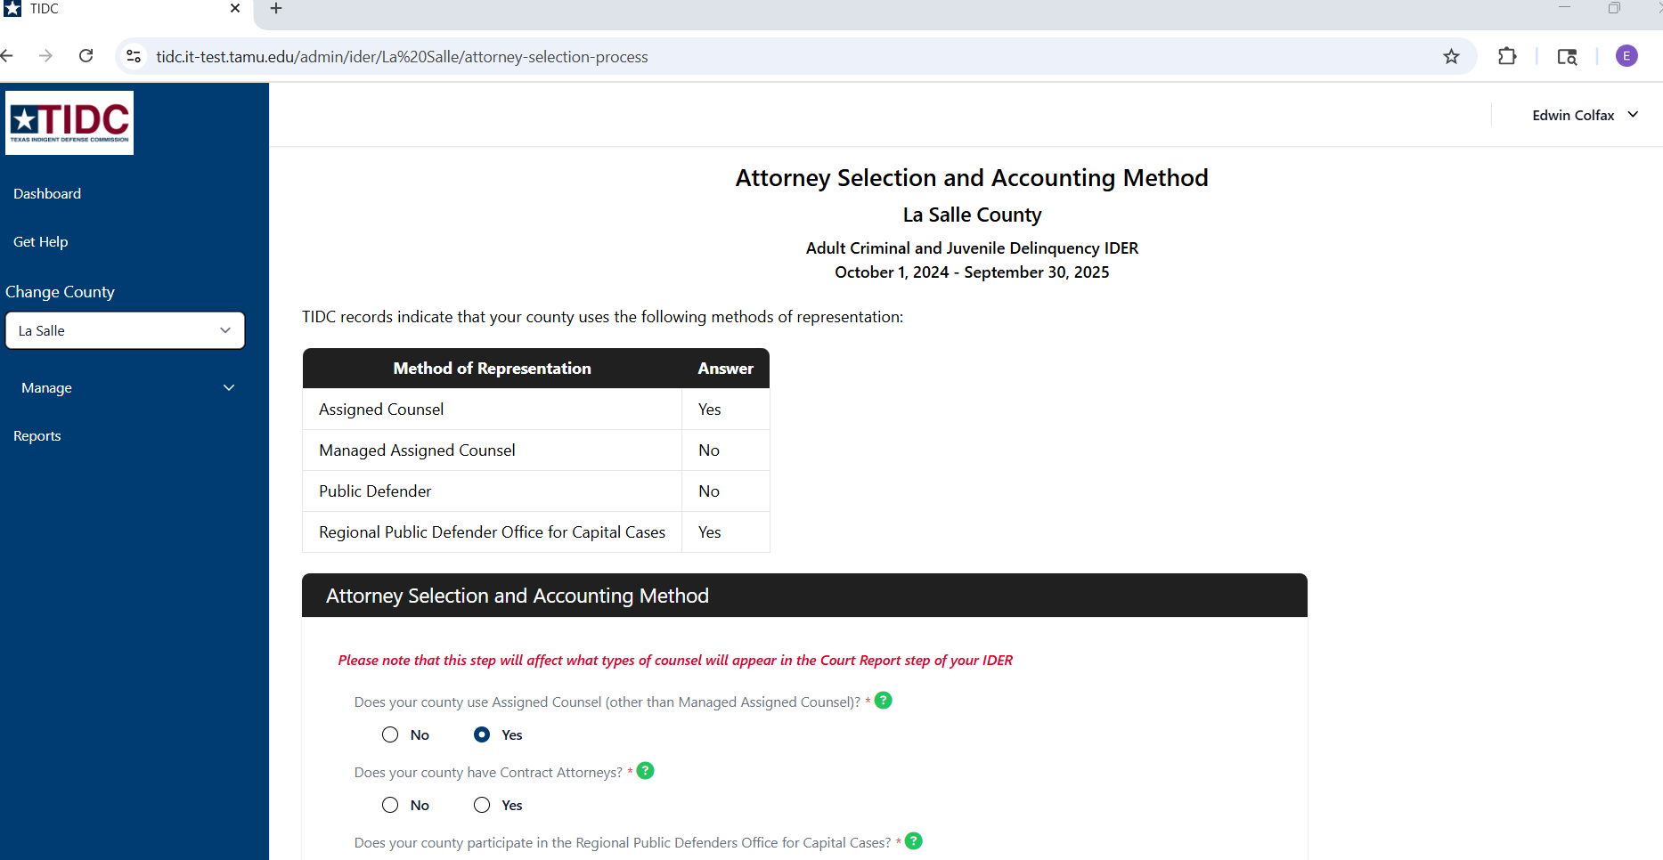

Slide 24
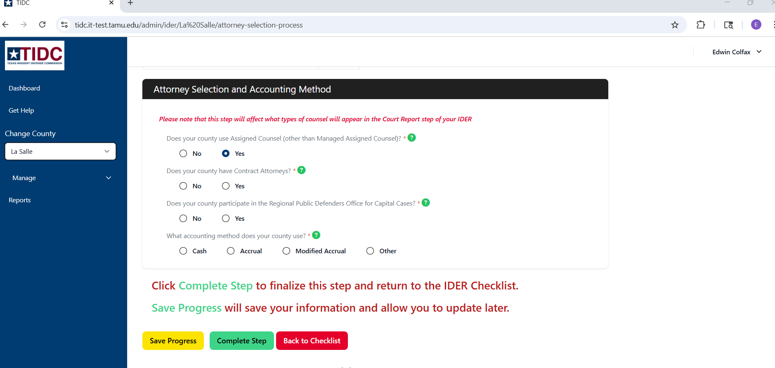

Slide 25
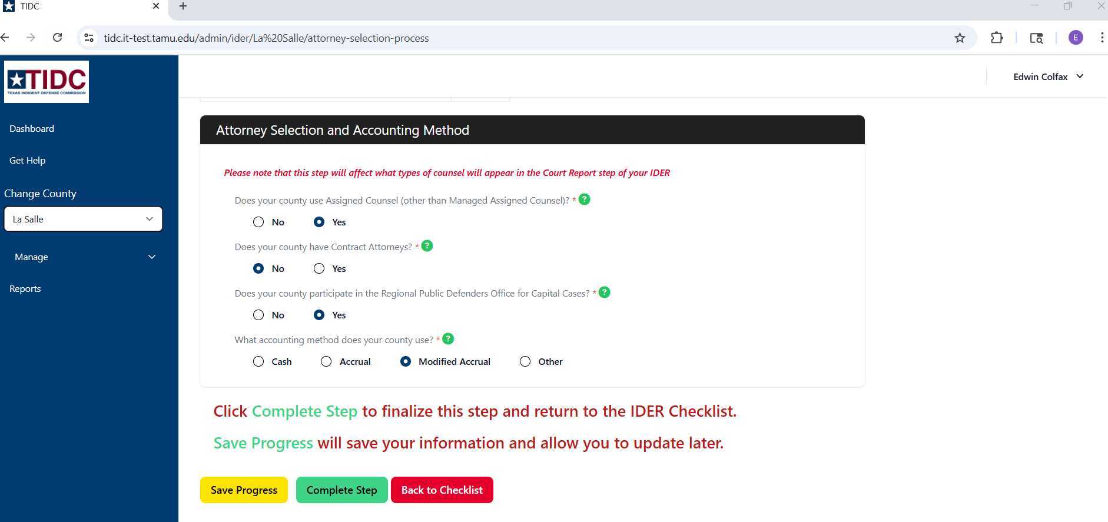

Slide 26
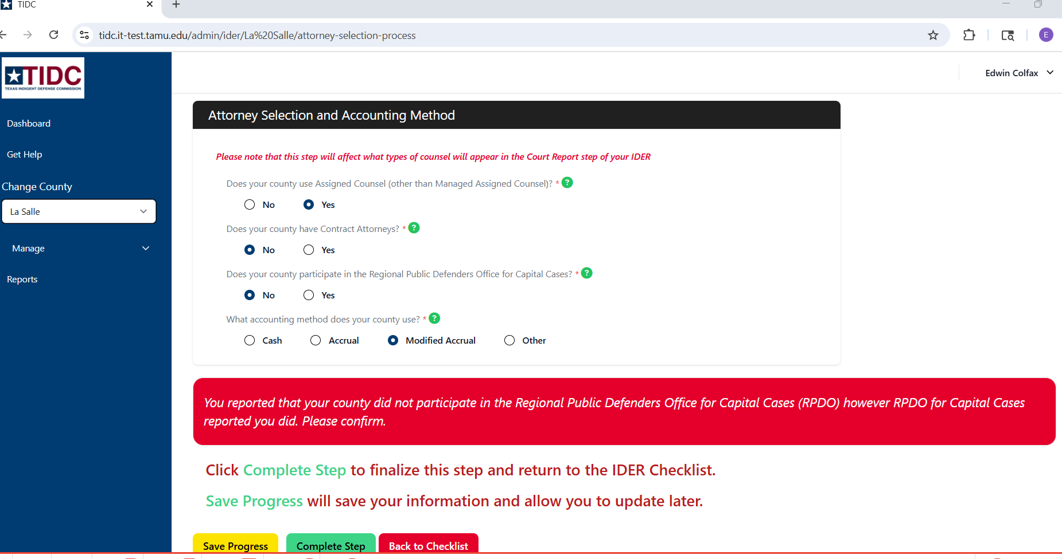

Slide 27
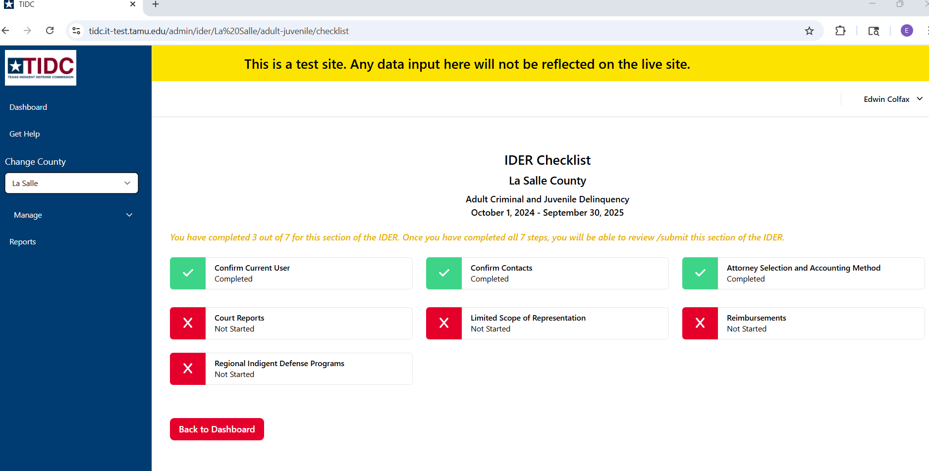

Slide 28
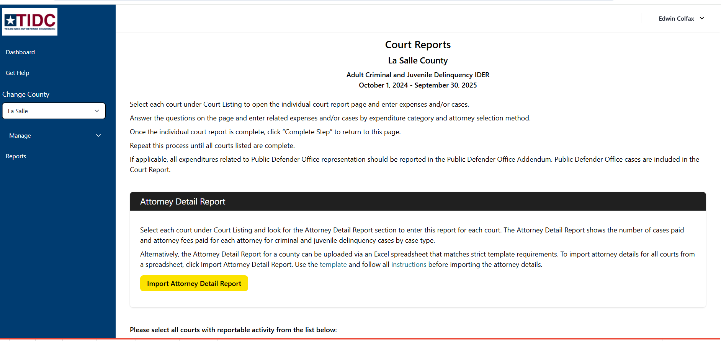

Slide 29
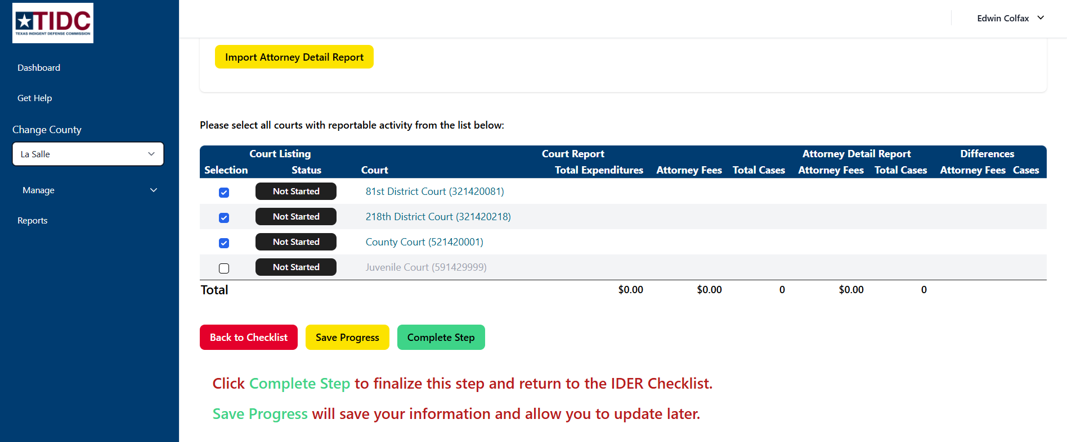

Slide 30
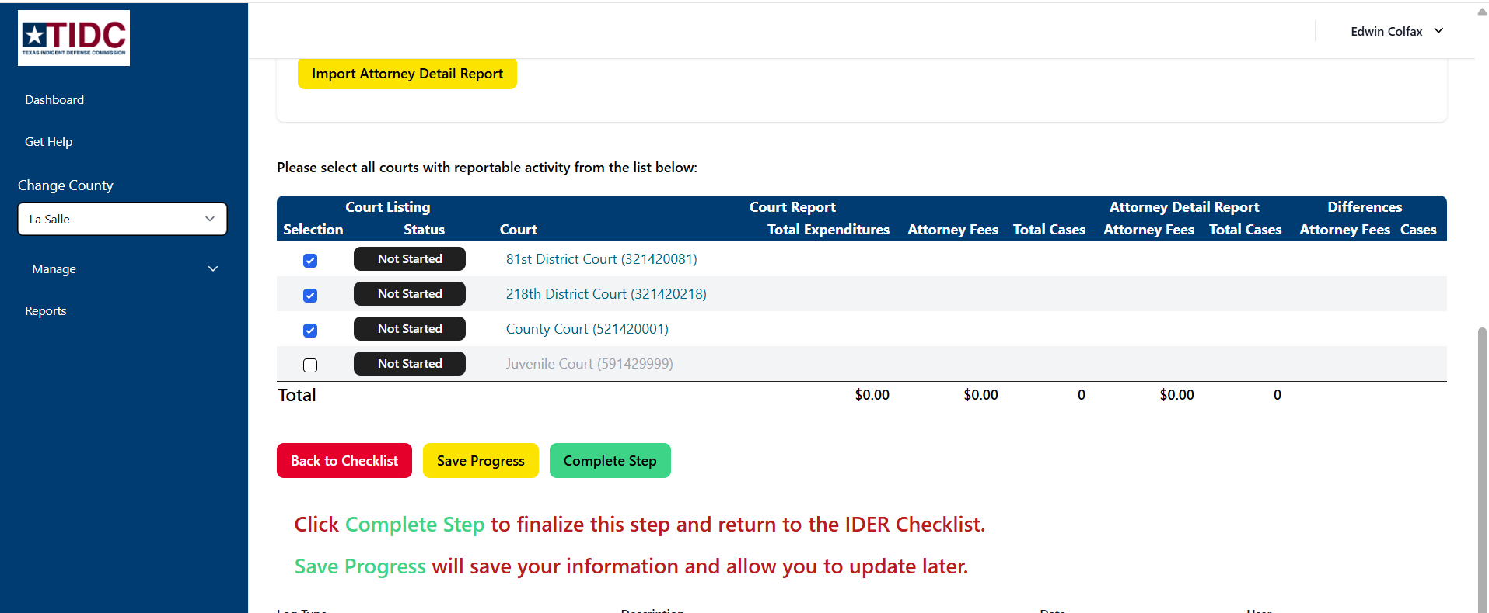

Slide 31
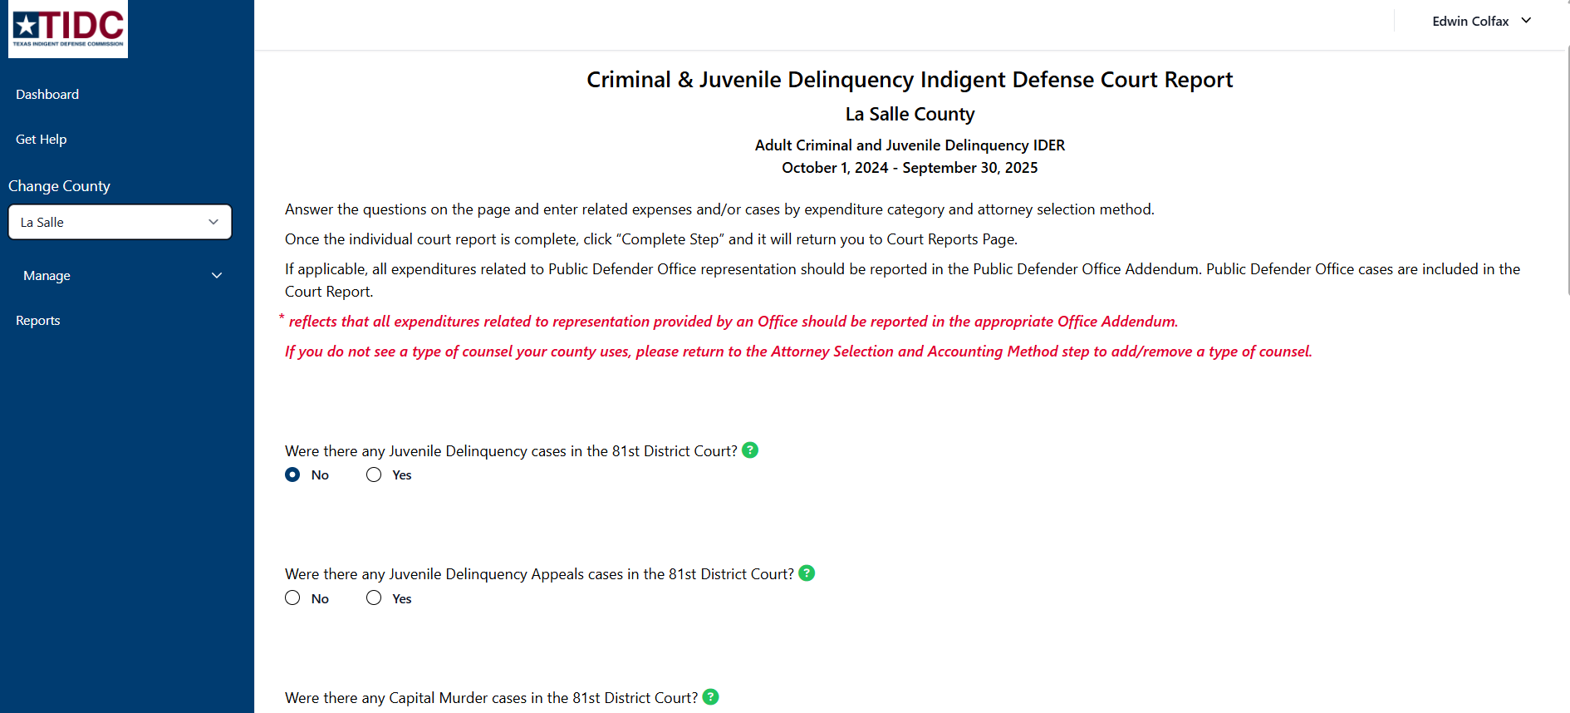

Slide 32
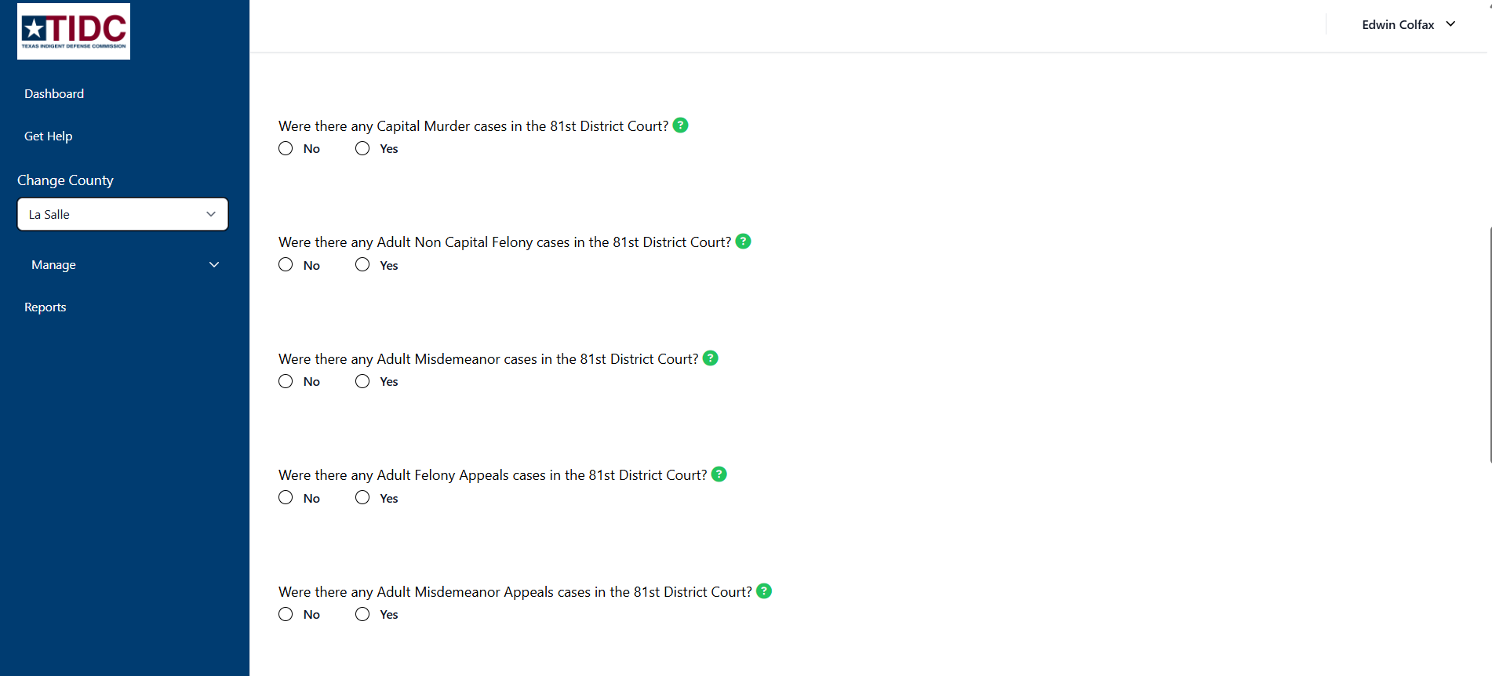

Slide 33
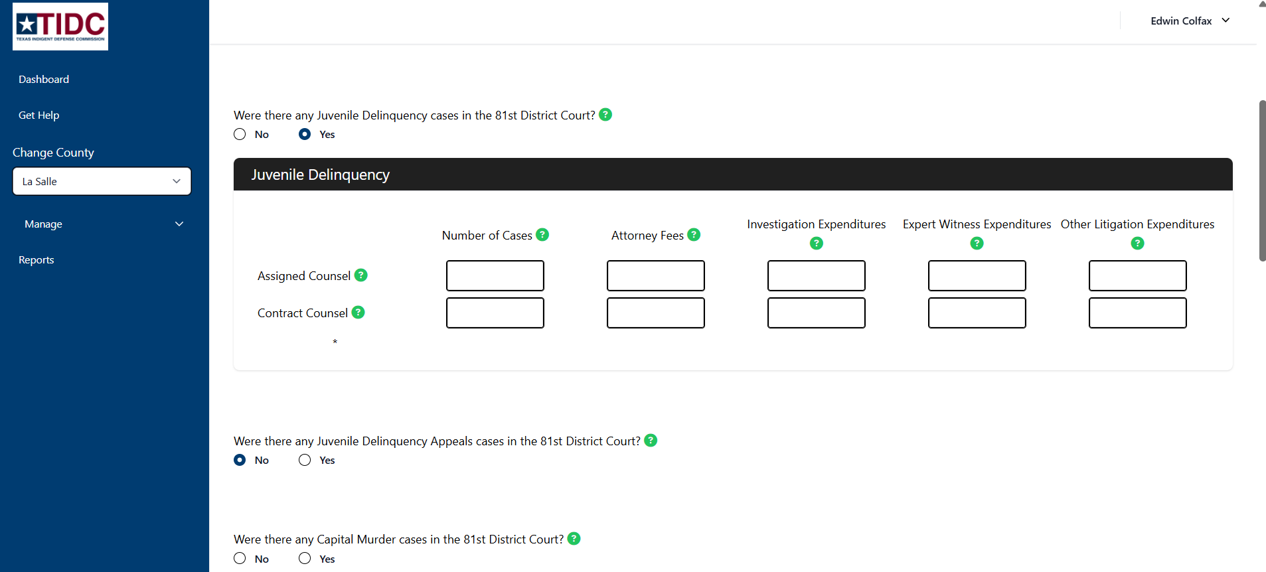

Slide 34
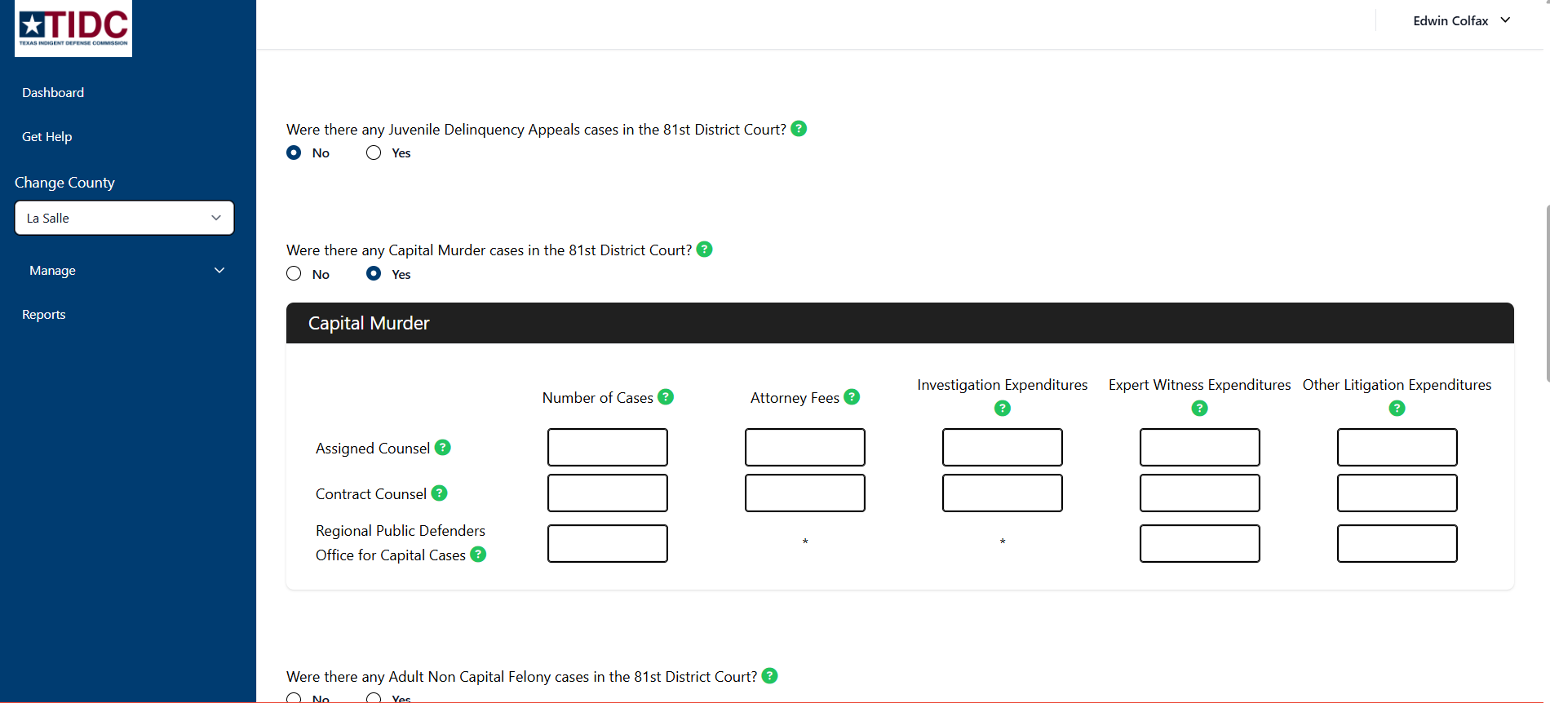

Slide 35
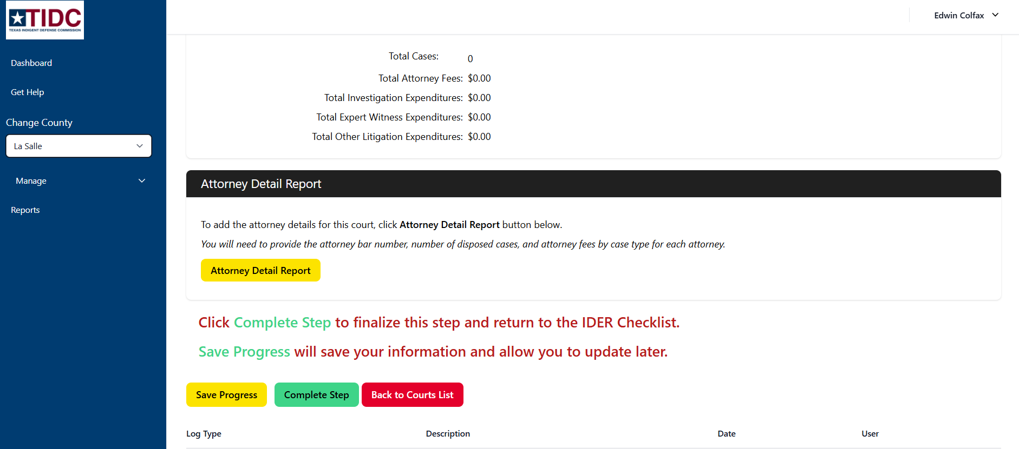

Slide 36
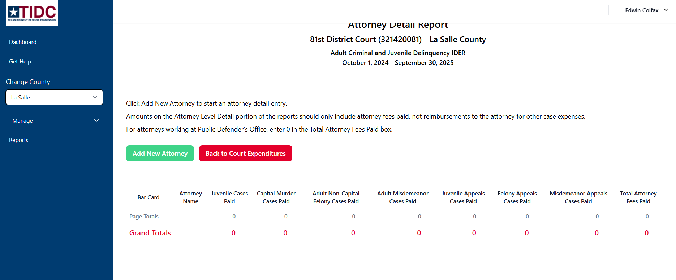

Slide 37
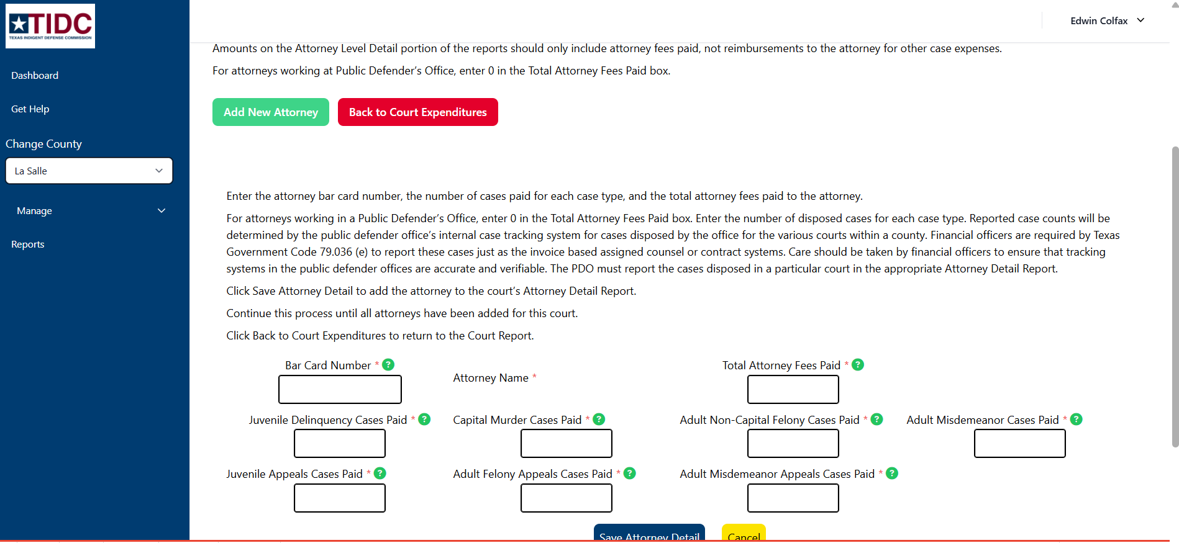

Slide 38
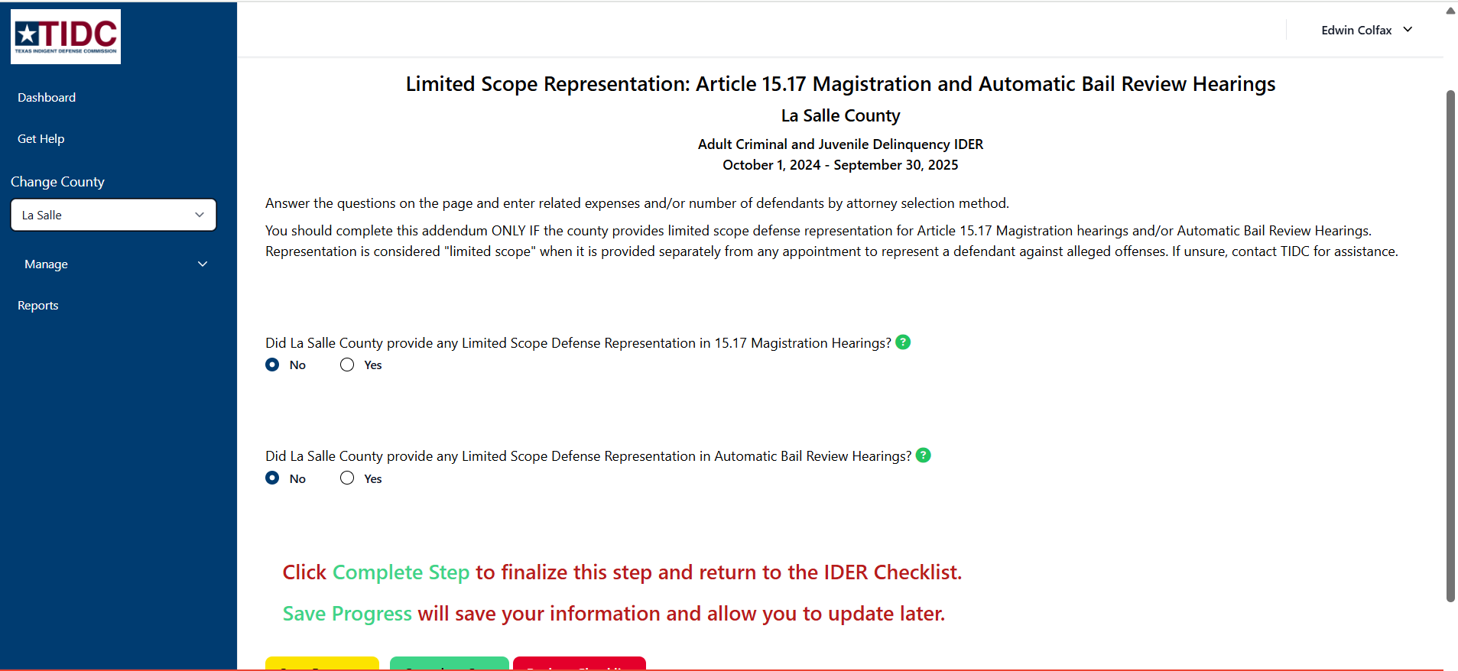

Slide 39
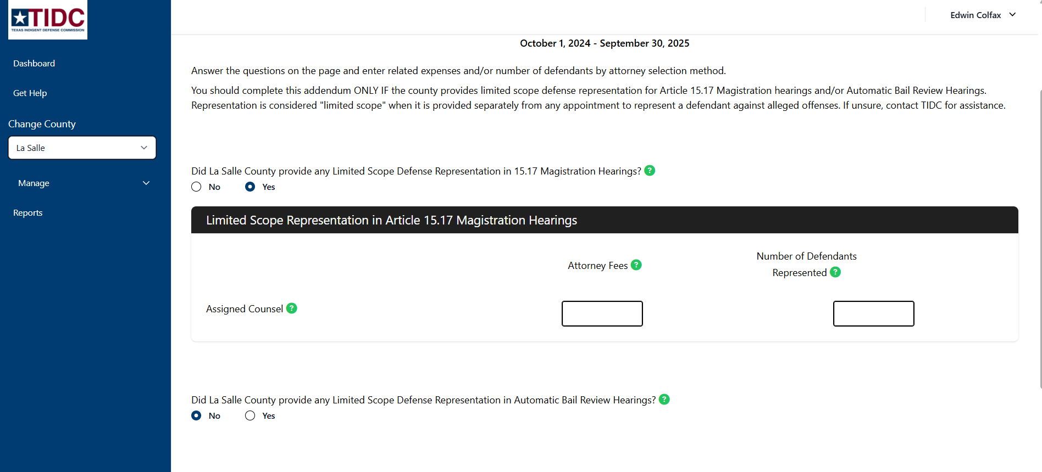

Slide 40
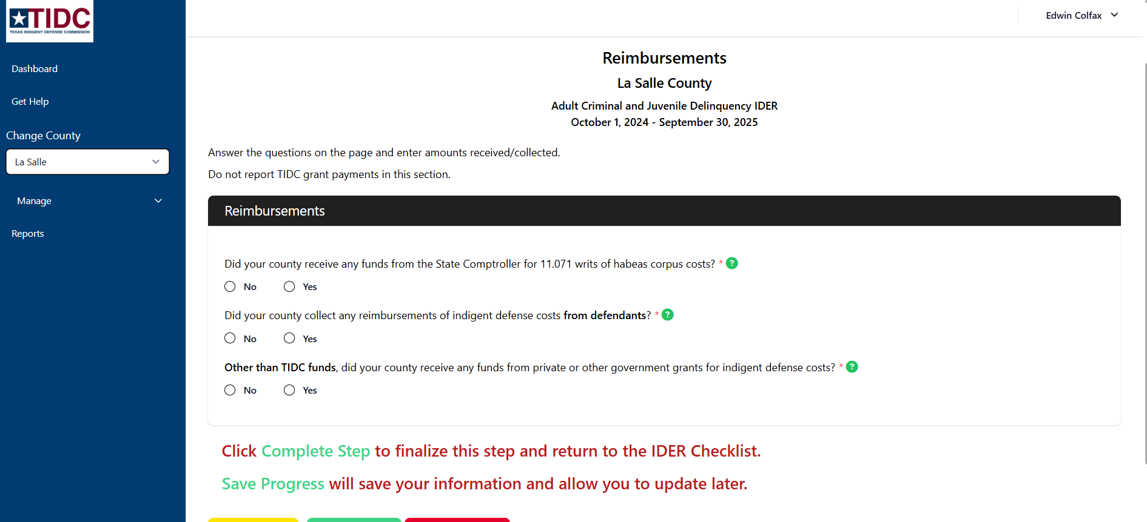

Slide 41
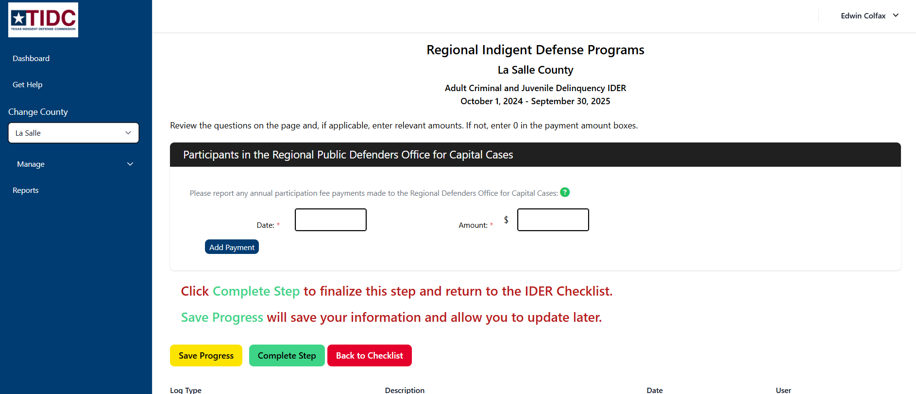

Slide 42
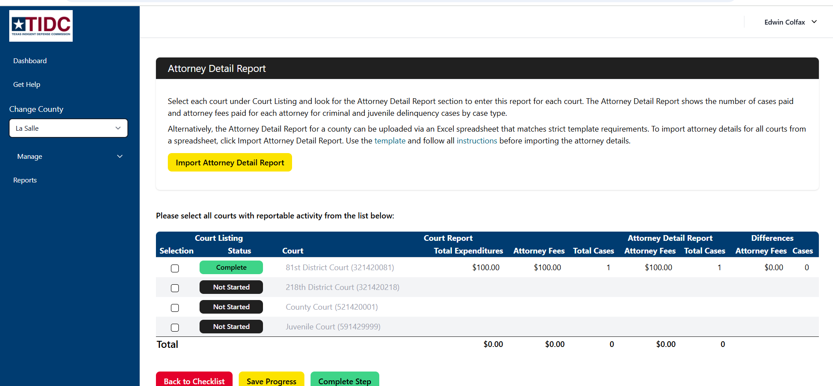

Slide 43
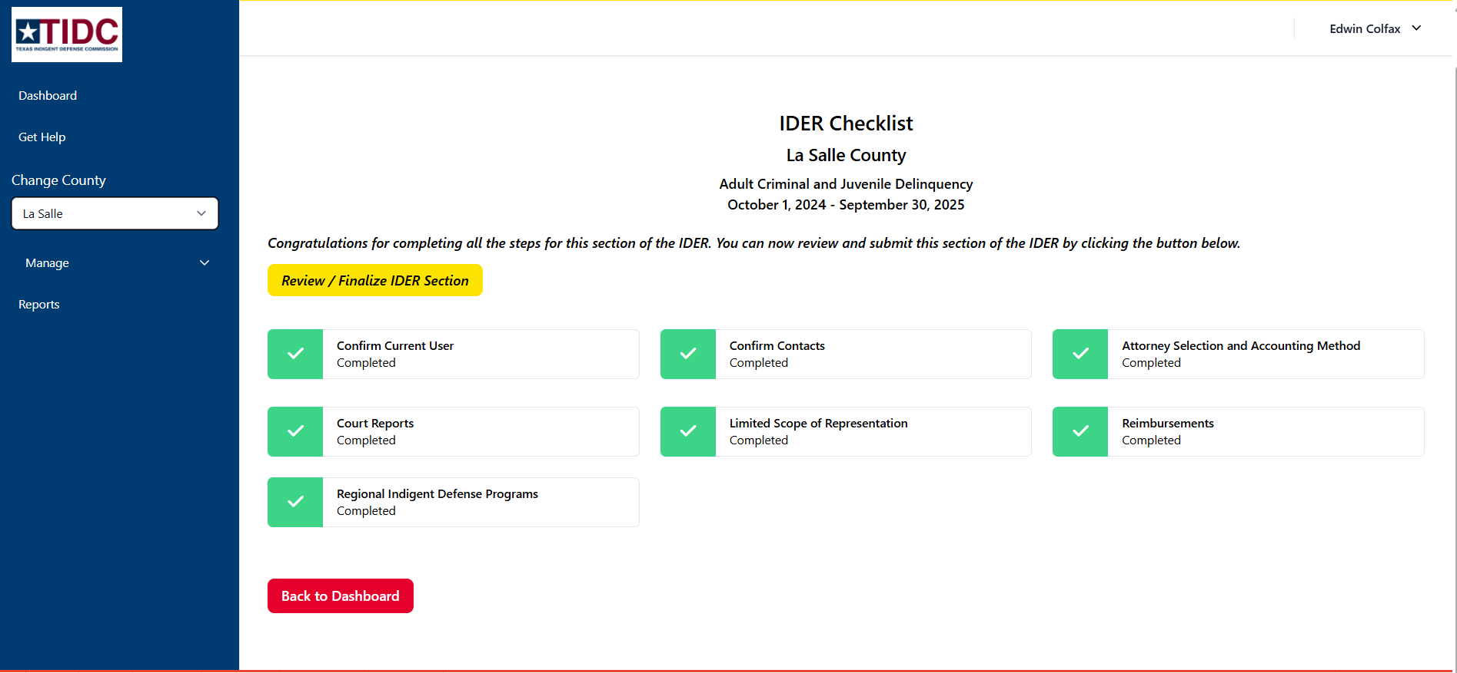

Slide 45
Some Counties will Have Additional IDER Sections
Counties that host public defender offices and/or managed assigned counsel offices will also complete
Public Defender Addendum
MAC Addendum
Public Defender/MAC Salary Addendum
(Counties that participate in regional PDs but are not host counties will not report these.)
Notes:
For criminal case reporting we do NOT look at civil cases which includes the CPS cases that we are discussing today.
It does NOT look at class C misdemeanors which are usually your traffic offenses nor any other non-jailable cases.

Slide 46
Indigent Defense Expenditure Report (IDER) Manual https://www.tidc.texas.gov/media/sjlncgtm/fy2025-indigent-defense-expenditure-manual.pdf
Notes:
For criminal cases.
We look at Adult Felony and A & B level misdemeanor
We also look at Juvenile delinquency and/or Child in need of supervision.(CINS) cases
Next slide please

Slide 47
Questions about the Criminal/Juvenile IDER?
Website/Login Issues
tidc@tamu.edu (979)845-6754
Crim/Juv IDER Report Content Questions
Debra Stewart
dstewart@tidc.texas.gov
512-936-7561
Edwin Colfax
ecolfax@tidc.texas.gov
512-463-2508
Notes:
For criminal case reporting we do NOT look at civil cases which includes the CPS cases that we are discussing today.
It does NOT look at class C misdemeanors which are usually your traffic offenses nor any other non-jailable cases.

